Slide 1

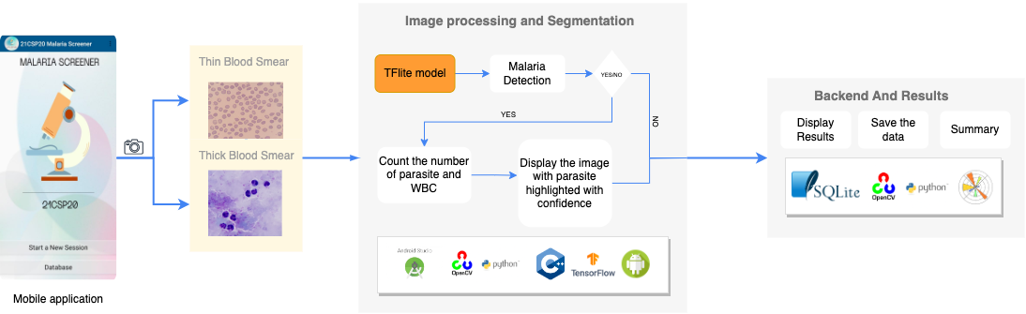
INVATI-2023
DETECTION OF MALARIA IN BLOOD CELLS USING CNN
ABSTRACT
Malarial infection in the blood cells is diagnosed by manually counting the number of parasites, RBCs and WBCs in the blood sample taken and our application is a system that enables users to take images of the blood sample and uses image segmentation and advanced deep learning techniques and diagnose malarial infection in the sample. The app is designed to serve in aid of the health professionals to help save time in finding and counting the parasites in the blood sample to give faster diagnosis.
PROBLEM STATEMENT
Implement a robust android and web application to take blood sample images and use advanced image segmentation and deep learning methods to diagnose malaria.
PROPOSED SYSTEM
OBJECTIVE
To help medical professionals expedite diagnosis by automatically counting the parasites in the blood sample.
Reduce the computational complexity of the model to ensure that the application can be used with devices of lowest specifications and can be used offline.
Intuitive Android Application
Fast malaria detection module
Improved Diagnosis Capability
Database for further data collection and analysis for research purposes.
CONCLUSION AND FUTURE WORK
Our project helps to considerably shave time required to manually count the parasites in the blood sample to aid the healthcare professionals give accurate and fast diagnosis. In the future we hope to extend the applications capability to detect other vector-based diseases similar to malaria like dengue, yellow fever etc.
APPLICATIONS
Self Diagnosis
Fast Detection of Parasites
Cost Effective Diagnosis
CONTRIBUTION
RESULTS
Model Accuracy- 96%
Diagnosis Time - Around a minute. Considerably faster than manual diagnosis which takes around 30 mins to manually count the parasites in the sample.
Anurag Nepal 1NT19CS036
Baibhav Dhakal 1NT19CS048
Avishek Rijal 1NT19CS045
Sabin Kandel 1NT19CS165
GUIDE
TEAM MEMBERS
Dr. Nalini N.
Professor(CSE) & Dean- Students’ Welfare, NMIT
Bangalore

